Slide 1

CSCI E-96 Data Mining, Exploration and Discovery Introduction to Clustering Models Part 2
Steve Elston
Copyright 2020,2021, 2022, 2023, 2024, Stephen F Elston. All rights reserved.

Slide 2
Clustering in High Dimensions and The Curse of Dimensionality!

Slide 3
What Could Possibly Go Wrong? Curse of Dimensionality!
Cluster models scale poorly with dimensionality
Consider sampling required to maintain the same uniformly distributed density in a hypercube:
An example of the Curse of Dimensionality!
Dimensions | Samples
1 | 10
2 | 100
3 | 1,000
5 | 10⁵
10 | 10¹⁰

Slide 4
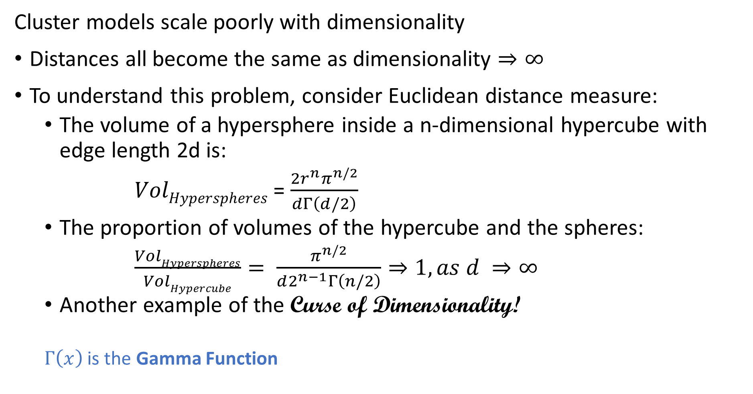
What Could Possibly Go Wrong? Curse of Dimensionality
Cluster models scale poorly with dimensionality
Distances all become the same as dimensionality $⇒∞$
To understand this problem, consider Euclidean distance measure:
The volume of a hypersphere inside a n-dimensional hypercube with edge length 2d is:
$VolHyperspheres$ = $\frac{2r^{n}π^{n/2}}{dΓ\left(d/2\right)}$
The proportion of volumes of the hypercube and the spheres:
$\frac{VolHyperspheres}{VolHypercube}= \frac{π^{n/2}}{d2^{n−1}Γ\left(n/2\right)}⇒1, as d ⇒∞$
Another example of the Curse of Dimensionality!
$Γ\left(x\right)$ is the Gamma Function

Slide 5
What Could Possibly Go Wrong? Curse of Dimensionality
The curse of dimensionality means that all clusters are the same in high dimensions
Sampling density decreases exponentially
Distances converge to the same size in a high dimensional space
The choice of metric does not help
All distances are the same in high dimensions!
Implication is that high-dimensional cluster models are easy to overfit!!

Slide 6
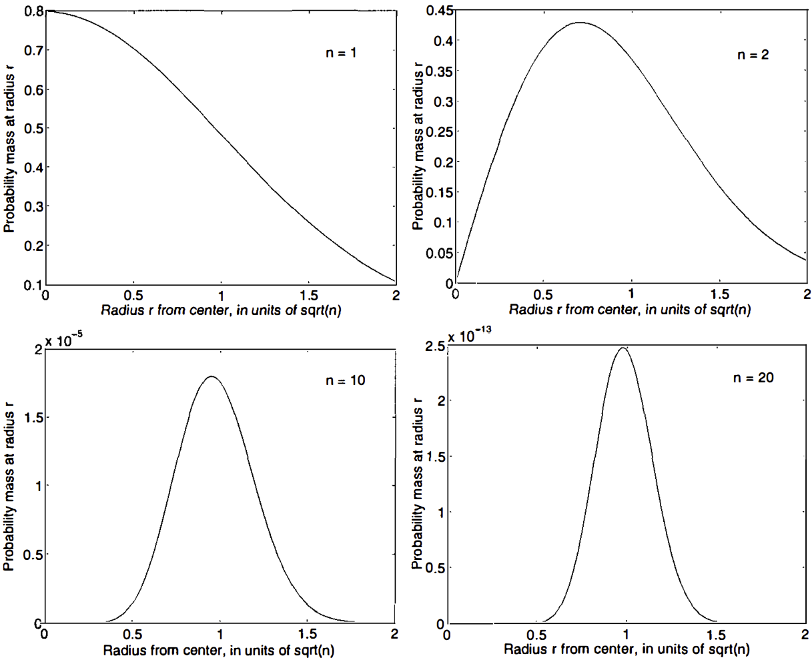
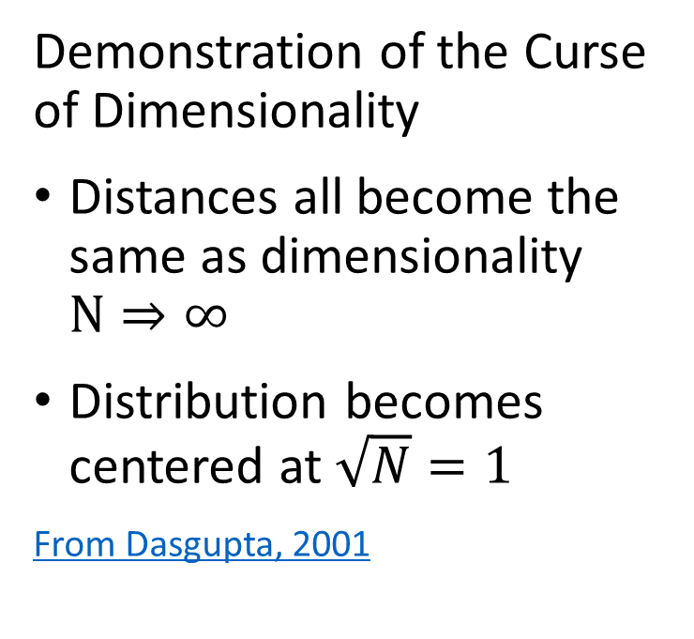
What Could Possibly Go Wrong? Curse of Dimensionality
Demonstration of the Curse of Dimensionality
Distances all become the same as dimensionality $N⇒∞$
Distribution becomes centered at $\sqrt{N}=1$
From Dasgupta, 2001

Slide 7
What Could Possibly Go Wrong? Curse of Dimensionality
How can we extend clustering to higher dimensions?
Reducing dimensionality can help
Need to create a lower dimensional embedding
But how?
PCA is a linear Euclidian projection
Several families of alternatives
Subspace clustering
Random projection
Manifold learning
Our next lesson!

Slide 8
Graph-Based Clustering Models

Slide 9
Graph Based Clustering Models
Many cluster models use a graph to model relationships
A graph is constructed for the distance or similarity relationships
Observations (samples) are nodes
Edges connect samples
Edge weights are distance or similarity
Relationships on the graph are used to separate data into clusters
Several commonly used classes of clustering algorithms are graph-based
Hierarchical
Affinity clustering
Density clustering
Spectral clustering

Slide 10
Scaling distance and similarity measures
A dissimilarity matrix contains the differences between each case x_{i} and every other case x’_{i}, d(x_{i}, x’_{i})
a dense computationally intensive and memory intensive representation: $O\left(\frac{{n(n}^{ }−1)}{2}\right)$
How can we do better?
Use a sparse graph representation!

Slide 11
Scaling distance and similarity measures
A dissimilarity matrix contains the differences between each case x_{i} and every other case x’_{i}, d(x_{i}, x’_{i})
Sparse graph representation reduces computation and memory use
In many practical situations only need measure for closest neighbors
Construct graph of nearest neighbors
Only compute and store measure for edges between nearest neighbors
Ways to define nearest neighbor
Neighbors within radius r
Nearest k neighbors

Slide 12
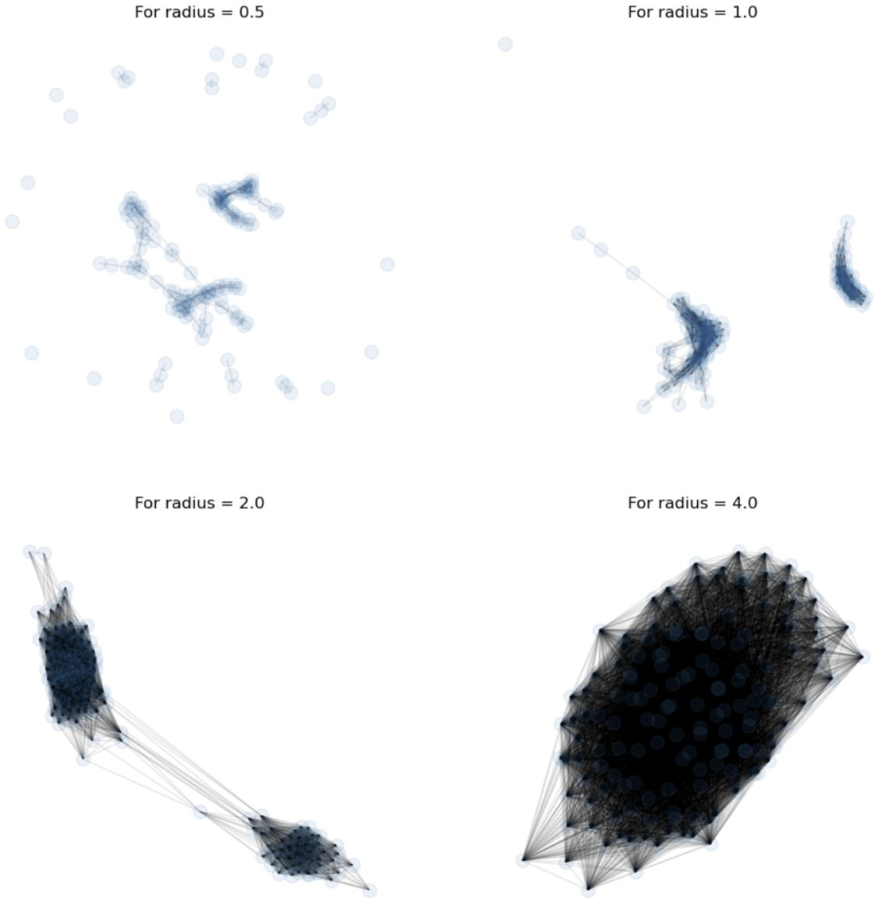
Scaling distance and similarity measures
Sparse graph representation reduces computation and memory use
Nearest neighbors within a fixed radius
Need to select a radius
Connectivity increases with radius
Lower $r⟶spaser graph$
Lower $r⟶less computation$
Lower $r⟶less memory$
Lower $r⟶disconnected graph$

Slide 13
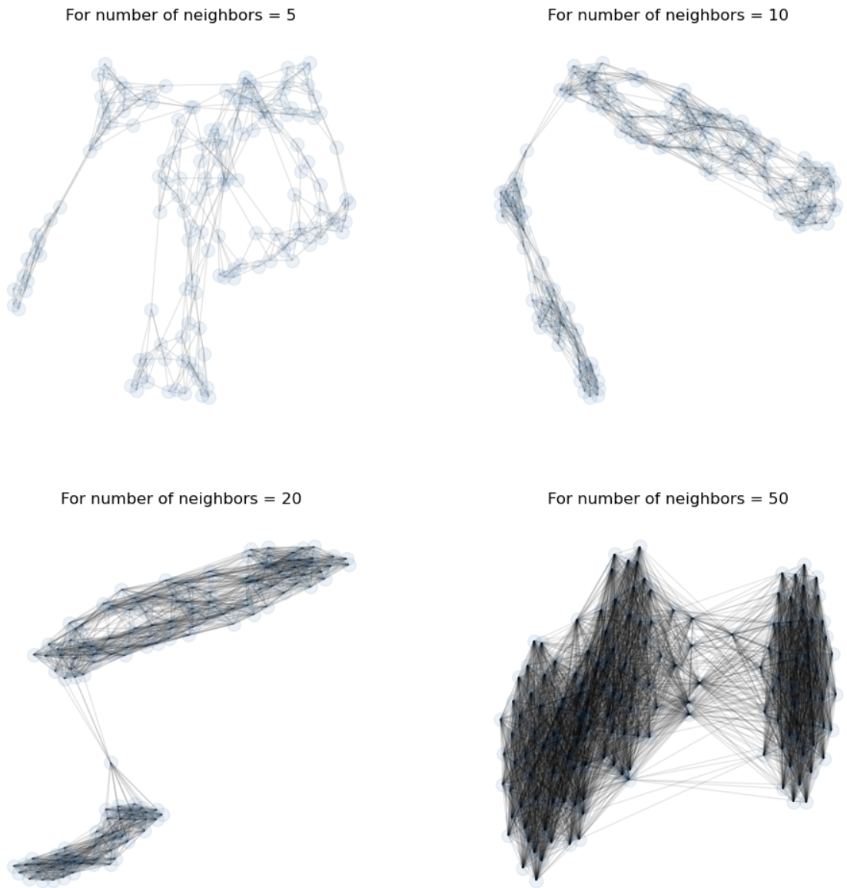
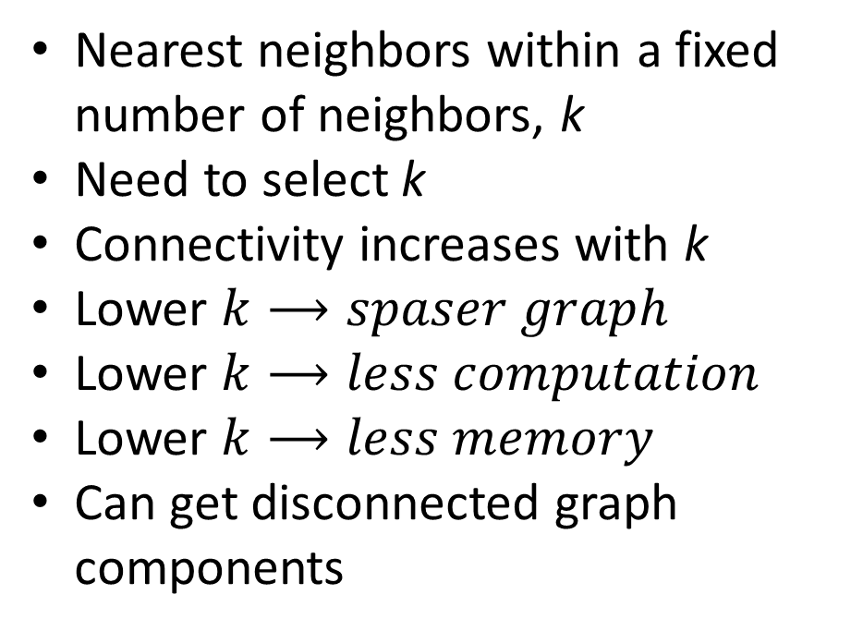
Scaling distance and similarity measures
Sparse graph representation reduces computation and memory use
Nearest neighbors within a fixed number of neighbors, k
Need to select k
Connectivity increases with k
Lower $k⟶spaser graph$
Lower $k⟶less computation$
Lower $k⟶less memory$
Can get disconnected graph components

Slide 14
Affinity-Based Clustering Models

Slide 15
Affinity Clustering
Can we build a clustering algorithm using a mapping to a few prototypes or exemplar points?
Yes
Affinity clustering uses a message passing algorithm to find these responsible or exemplar points and create a graph of cluster members
Affinity clustering provides useful results in many situations
Document similarity
Computer vision
Computational genetics
Etc.

Slide 16
Affinity Clustering
Can we build a clustering algorithm using a relationship to a few prototypes or exemplar points?
The number of representative points, and clusters, are determined by the algorithms
No need to specify number of clusters apriori
The message passing algorithm iteratively determines
Responsibility, r(i,k), of sample k to be the exemplar of sample i
Availability, a(i,k), of sample k to be a member of cluster with exemplar i
Exemplar points are central nodes on a graph component
Graph components have no edges between them
Samples in component are connected to the exemplars by undirected edges

Slide 17
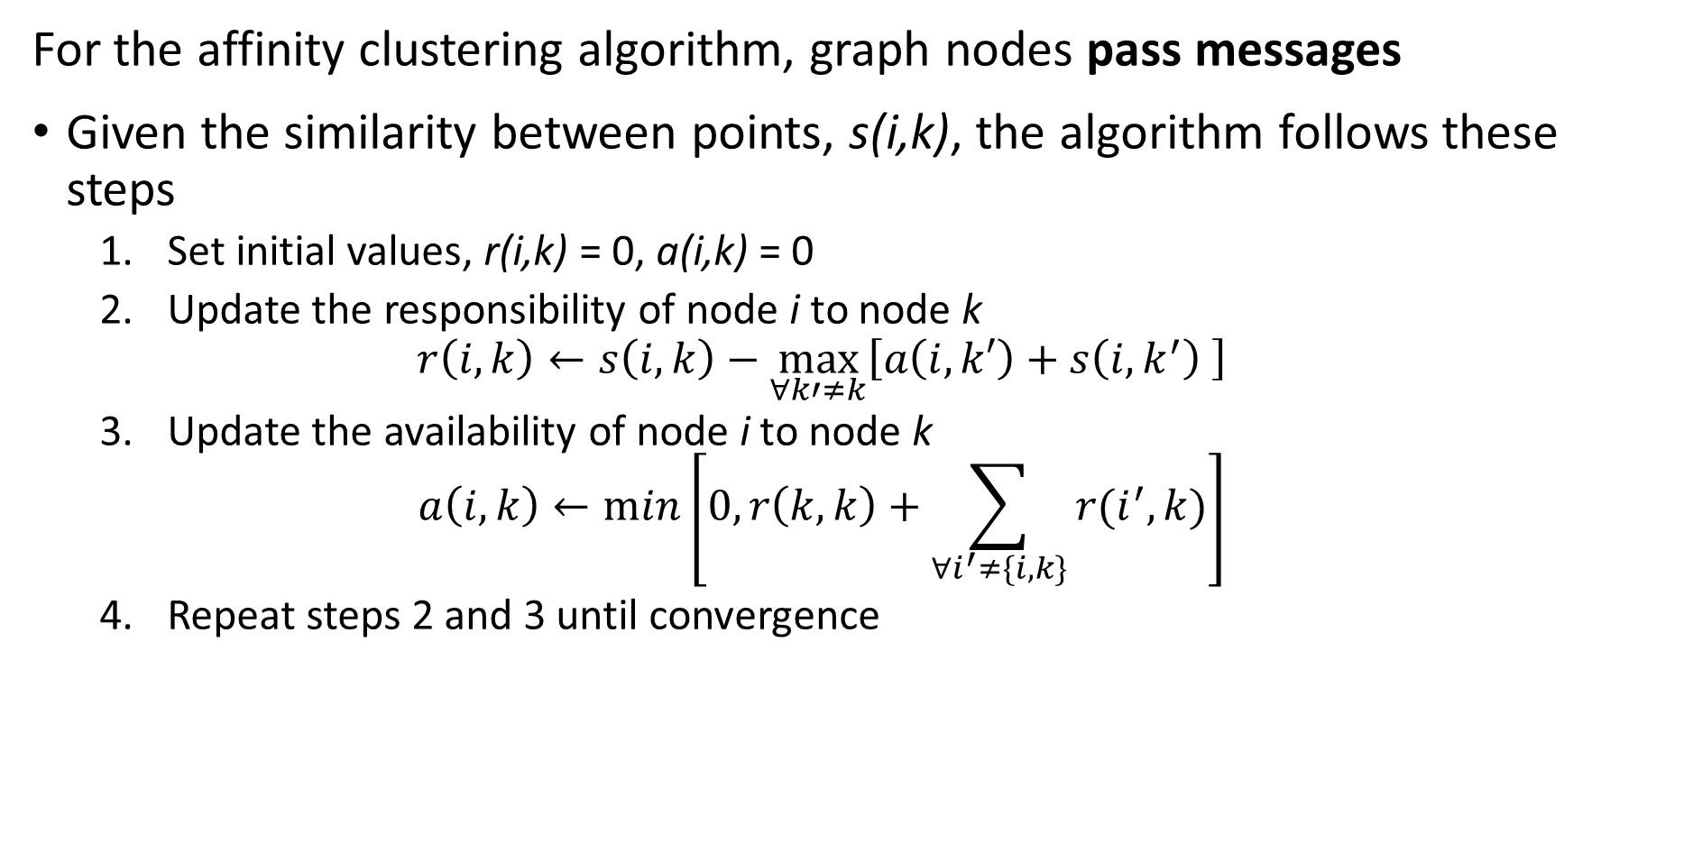
Affinity Clustering
For the affinity clustering algorithm, graph nodes pass messages
Given the similarity between points, s(i,k), the algorithm follows these steps
Set initial values, r(i,k) = 0, a(i,k) = 0
Update the responsibility of node i to node k
$$r\left(i,k\right)←s\left(i,k\right)−\max_{∀k′≠k}{⁡\left[a\left(i,k′\right)+s\left(i,k^{′}\right) \right]}$$
Update the availability of node i to node k
$$a\left(i,k\right)←min⁡\left[0,r\left(k,k\right)+\sum_{∀i^{′}≠\{i,k\}}^{ }{r(i^{′},k)}\right]$$
Repeat steps 2 and 3 until convergence

Slide 18
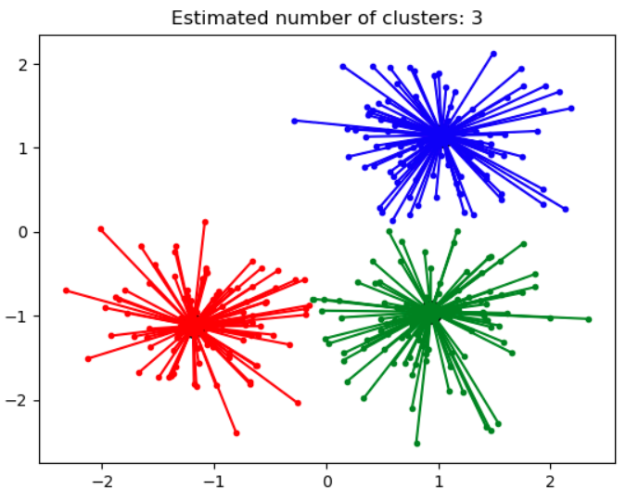
Affinity Clustering
Affinity propagation determines a number of clusters
Clusters linearly separated and convex
Clusters area Voronoi regions
Different similarity metrics create different clusters
Algorithm can be slow, O(n²) complexity
Credit: Scikit-Learn development team; Pedregosa et al., JMLR 12, pp. 2825-2830, 2011

Slide 19
Density-Based Clustering Models

Slide 20
Density Clustering
Using sample density is another way to form clusters
High density points form clusters
How can we find high density points?
Find points with large number of near neighbors
Form clusters around these high density points
Naive algorithms have high complexity
Scalable algorithms are largely heuristic
Many algorithms proposed, including
DBSCAN
OPTICS

Slide 21
Density Clustering
DBSCAN was the first (1996) large-scale density-based clustering algorithm
DBSCAN still in use today
Many variations created
DBSCAN scales to out of memory dataset size
DBSCAN minimizes the number of passes through the data base
Can scale DBSCAN with MapReduce

Slide 22
Density Clustering
DBSCAN finds a directed graph of nearest neighbors
Core points define the high density areas
Reachable non-core points are in a cluster but not core
Unreachable points are not in a cluster, outliers
Graph edge is bidirectional if both points are core
Graph edges from core to reachable non-core point are unidirectional

Slide 23
Density Clustering
Properties of DBSCAN algorithm
DBSCAN has two hyperparameters
minPts is the minimum number of near neighbors a core point must have
ε is the maximum distance between neighbors
DBSCAN makes passes thorough a database to create the graph
Highly scalable, O(n log(n))
Uses memory, O(n²)

Slide 24
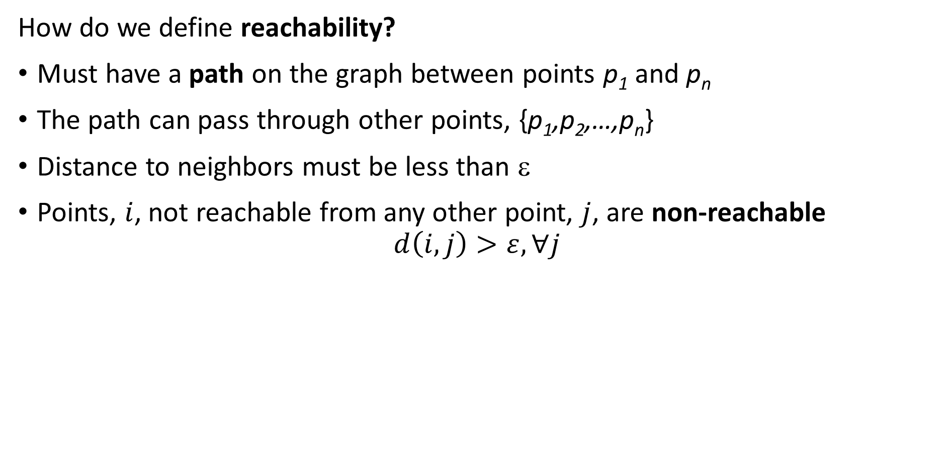
Density Clustering
How do we define reachability?
Must have a path on the graph between points p₁ and p_{n}
The path can pass through other points, {p₁,p₂,…,p_{n}}
Distance to neighbors must be less than ε
Points, $i$, not reachable from any other point, $j$, are non-reachable
$$d\left(i,j\right)>ε, ∀j$$

Slide 25
Density Clustering
What are the steps of DBSCAN?
Start with some samples or observations
For each point, find near neighbors within distance ε
A point is core if it has > minPts near neighbors (2 in this example)
If two point are core, connect with undirected edge
If point is non-core, connect with directed edge
If point further that ε from neighbors, point is non-reachable
Result is a graph

Slide 26
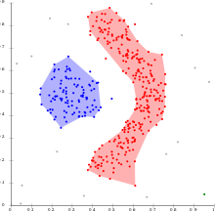
Density Clustering
What are some properties of DBSCAN?
Can find non-convex clusters
Is fast and efficient
Optimized for uniform sample density of clusters with fixed ε and minPts
Selecting maximum distance to neighbors, ε, is difficult in high dimensions
Clusters depend on distance metric
Clusters robust to noise, non-reachable samples
Credit: Wikipedia commons

Slide 27
Density Clustering
How can we overcome the limitations of DBSCAN?
Optimized for uniform density clusters
Hard to find good value of ε in high dimensions
The OPTICS algorithm is an improvement on DBSCAN
OPTICS uses a heuristic to find adaptive reachability distances
Core distance determines if a sample is core
Reachability distance determines if one sample is reachable from the other
Only one mandatory hyperparameter, min_pts

Slide 28
Density Clustering
OPTICS is performs a sequential search
OPTICS compute reachability to points sequentially
The order of the search though observations maters
A difference from DBSCAN
The reachability of each point is determined by the previously processed points in a cluster
Creates a reachability graph
Points are saved in a queue and processed in order
Reachability calculated based on neighbors on graph
Reachability search is done for nearest neighbors
Based on the reachability graph clusters are formed
Clusters formed by partitioning graph constrained by min_pts

Slide 29
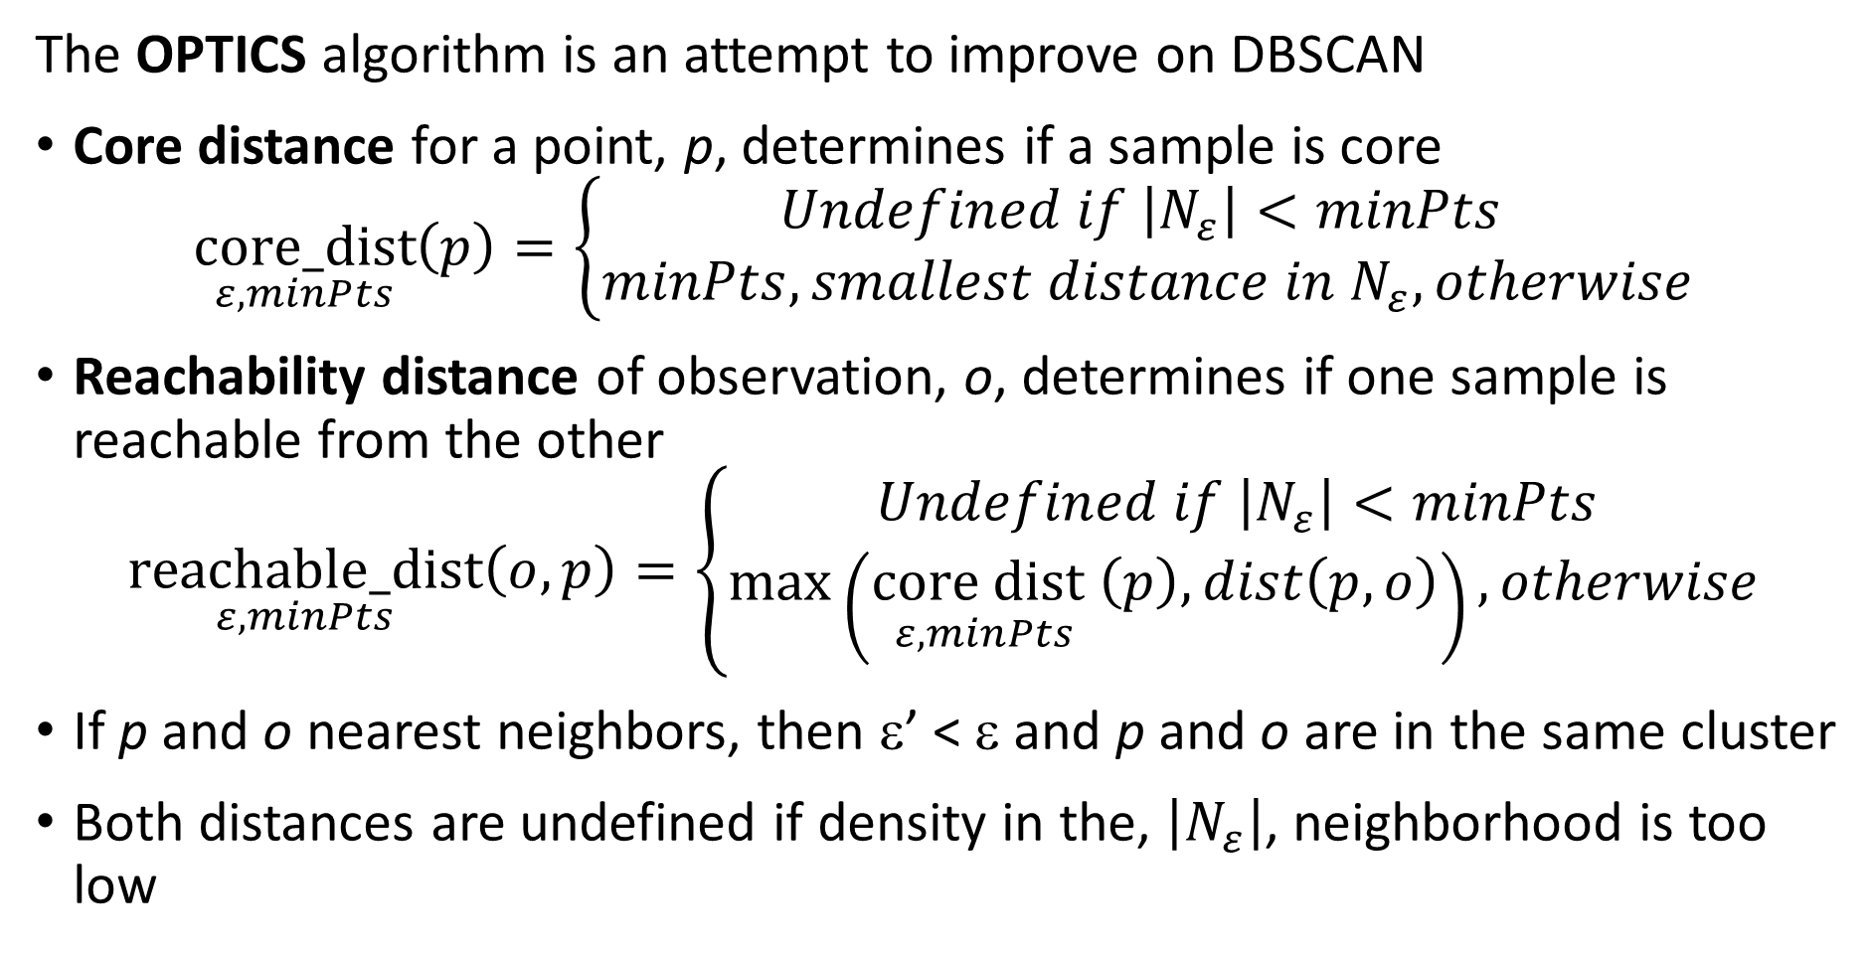
Density Clustering
The OPTICS algorithm is an attempt to improve on DBSCAN
Core distance for a point, p, determines if a sample is core
$$\underset{ε,minPts}{core_dist}\left(p\right)=\left\{\begin{aligned}Undefined if \left|N_{ε}\right|<minPts \\ minPts, smallest distance in N_{ε}, otherwise\end{aligned}\right.$$
Reachability distance of observation, o, determines if one sample is reachable from the other
$$\underset{ε,minPts}{reachable_dist}\left(o,p\right)=\left\{\begin{aligned}Undefined if \left|N_{ε}\right|<minPts \\ \max\left(\underset{ε,minPts}{{core dist}_{ }}\left(p\right),dist\left(p,o\right)\right), otherwise\end{aligned}\right.$$
If p and o nearest neighbors, then ε’ < ε and p and o are in the same cluster
Both distances are undefined if density in the, $\left|N_{ε}\right|$, neighborhood is too low

Slide 30
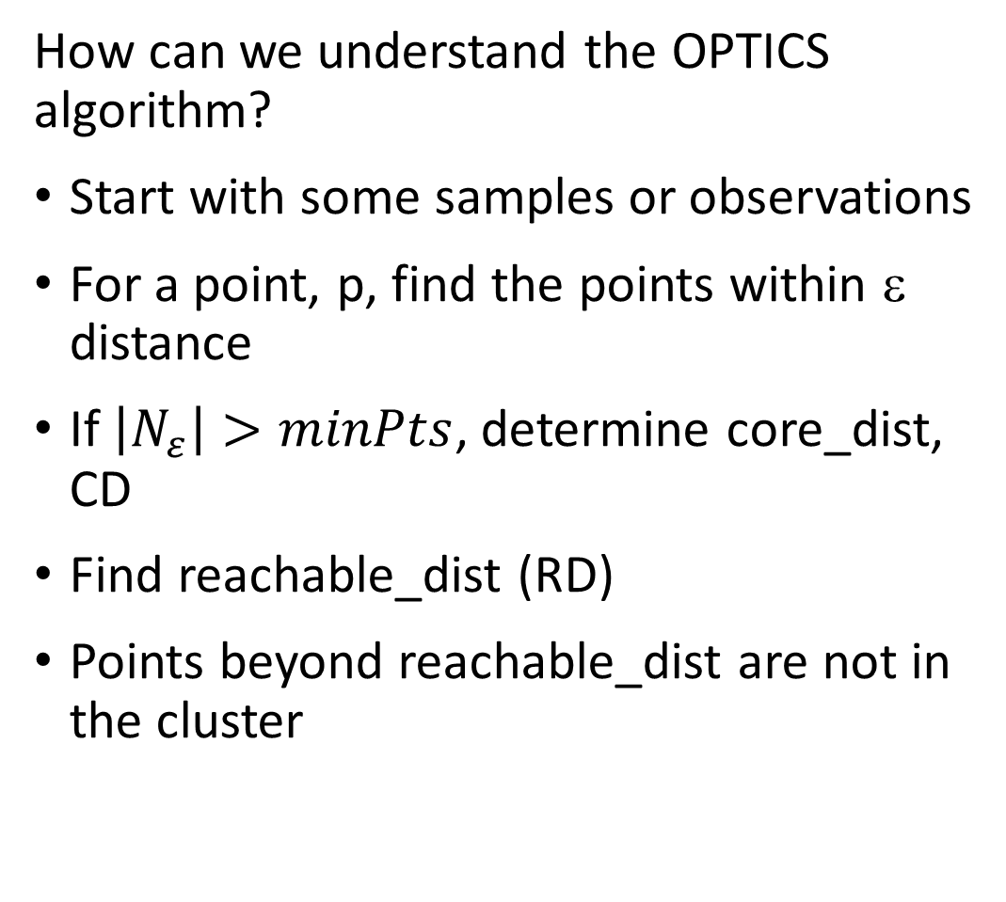
Density Clustering
How can we understand the OPTICS algorithm?
Start with some samples or observations
For a point, p, find the points within ε distance
If $\left|N_{ε}\right|>minPts$, determine core_dist, CD
Find reachable_dist (RD)
Points beyond reachable_dist are not in the cluster
ε
CD
RD

Slide 31
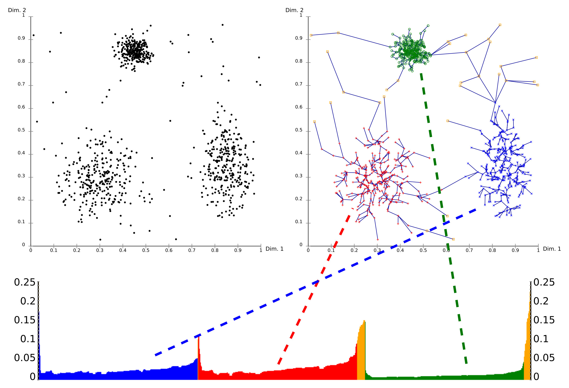
Density Clustering
What are some properties of OPTICS?
OPTICS builds a graph with the distances determining clusters
The graph defines a dendrogram
The reachability plot (bottom) shows the path distances in the dendrogram
A cutoff on the reachability plot defines the clusters
Credit: Wikipedia commons

Slide 32
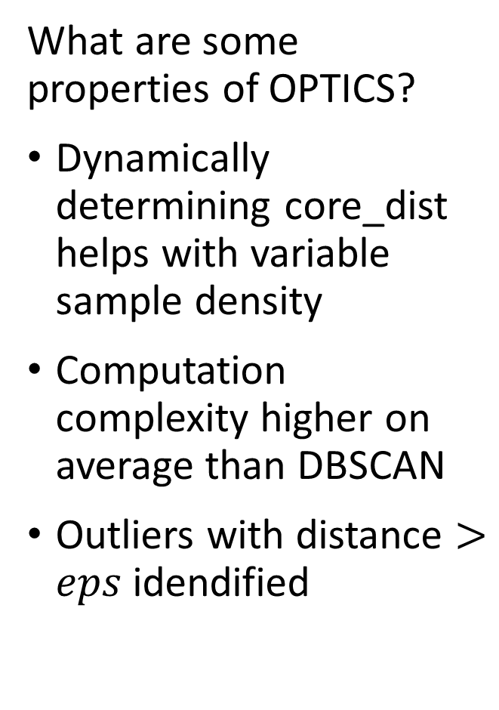
Density Clustering
What are some properties of OPTICS?
Dynamically determining core_dist helps with variable sample density
Computation complexity higher on average than DBSCAN
Outliers with distance $>eps$ idendified
Credit: Wikipedia commons

Slide 33
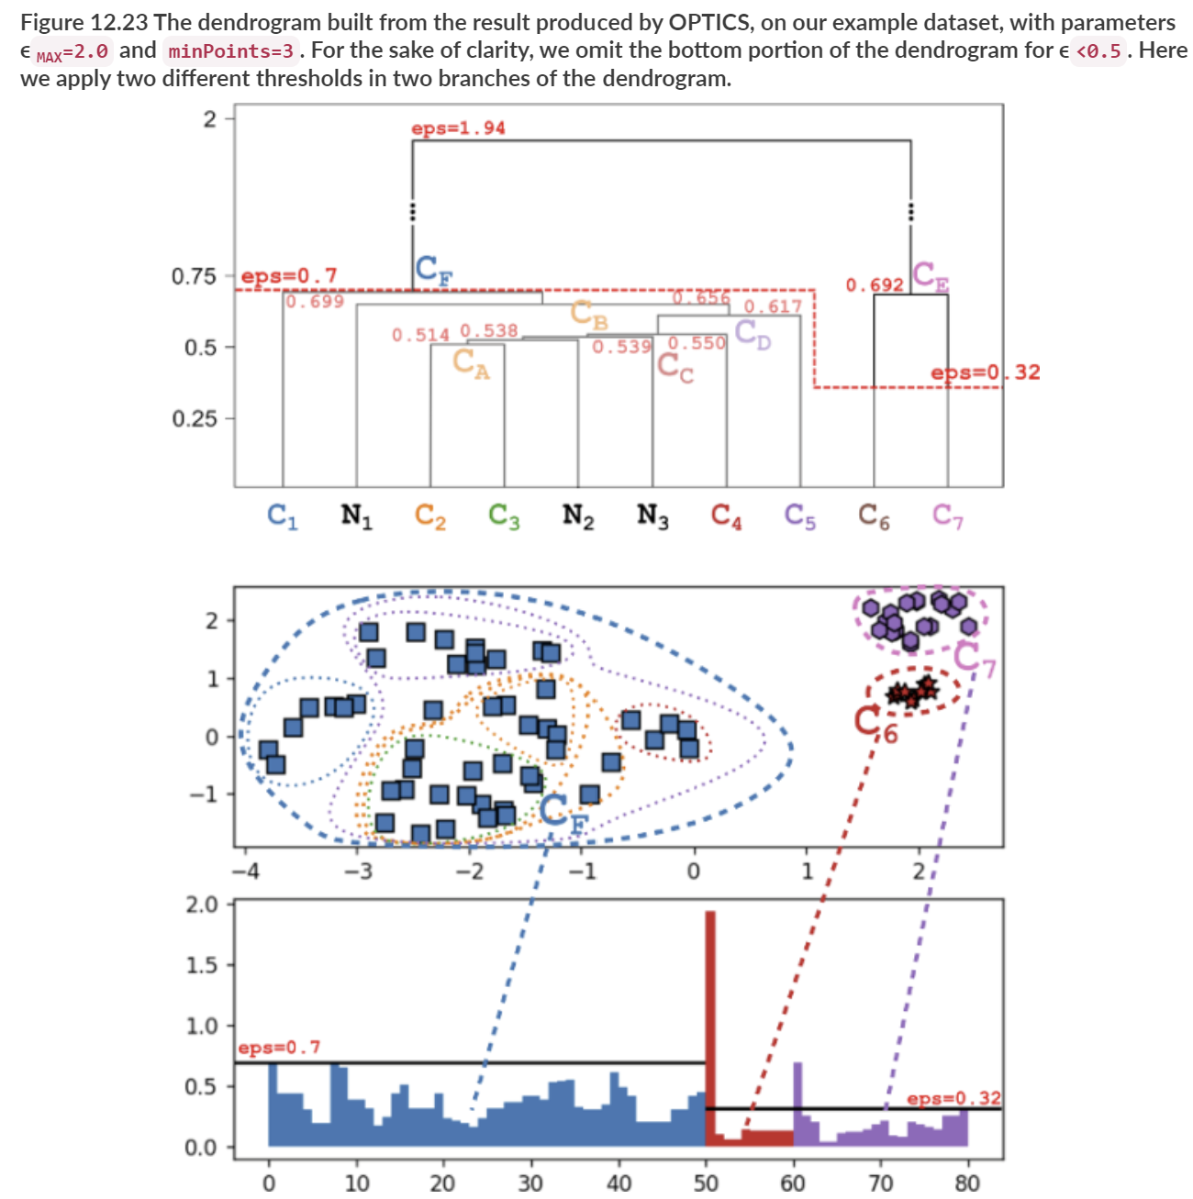
Density Clustering
OPTICS is an Hierarchical Algorithm
Dendrogram of reachability distances
Overlapping cluster assignments from partitioning graph at different eps
Reachability plot with local eps to define clusters from graph components
From Advanced Algorithms and Data Structures,, Marcello La Rocca, Manning, 2021

Slide 34
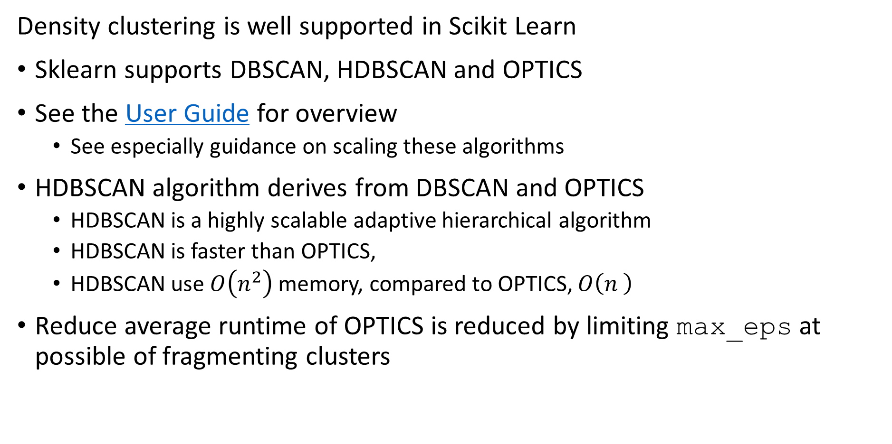
Density Clustering
Density clustering is well supported in Scikit Learn
Sklearn supports DBSCAN, HDBSCAN and OPTICS
See the User Guide for overview
See especially guidance on scaling these algorithms
HDBSCAN algorithm derives from DBSCAN and OPTICS
HDBSCAN is a highly scalable adaptive hierarchical algorithm
HDBSCAN is faster than OPTICS,
HDBSCAN use $O\left(n^{2}\right)$ memory, compared to OPTICS, $O\left(n^{ }\right)$
Reduce average runtime of OPTICS is reduced by limiting max_eps at possible of fragmenting clusters

Slide 35
Spectral Clustering Models

Slide 36
Spectral Clustering
Steps of spectral clustering algorithm
Construct the graph of the samples
Fully connected graph
Sparse K-nearest-neighbor graph – use KD-tree or ball-tree
Generally use symmetric nearest neighbors
The edges are undirected and weighted
Weights are the similarity between the samples
The weighted association matrix is constructed
Full matrix for fully connected graph
Sparse matrix for nearest-neighbor graph – faster algorithm!
Need not be symmetric

Slide 37
Spectral Clustering
Steps of spectral clustering algorithm
Start with samples
Construct graph
3-nearest-neighbors in this case
Use undirected edges
Edge weights are similarity
Association matrix constructed from graph
Weighted by similarity between points
Compute graph Laplacian
Perform clustering by portioning graph on eigenvectors of graph Laplacian

Slide 38
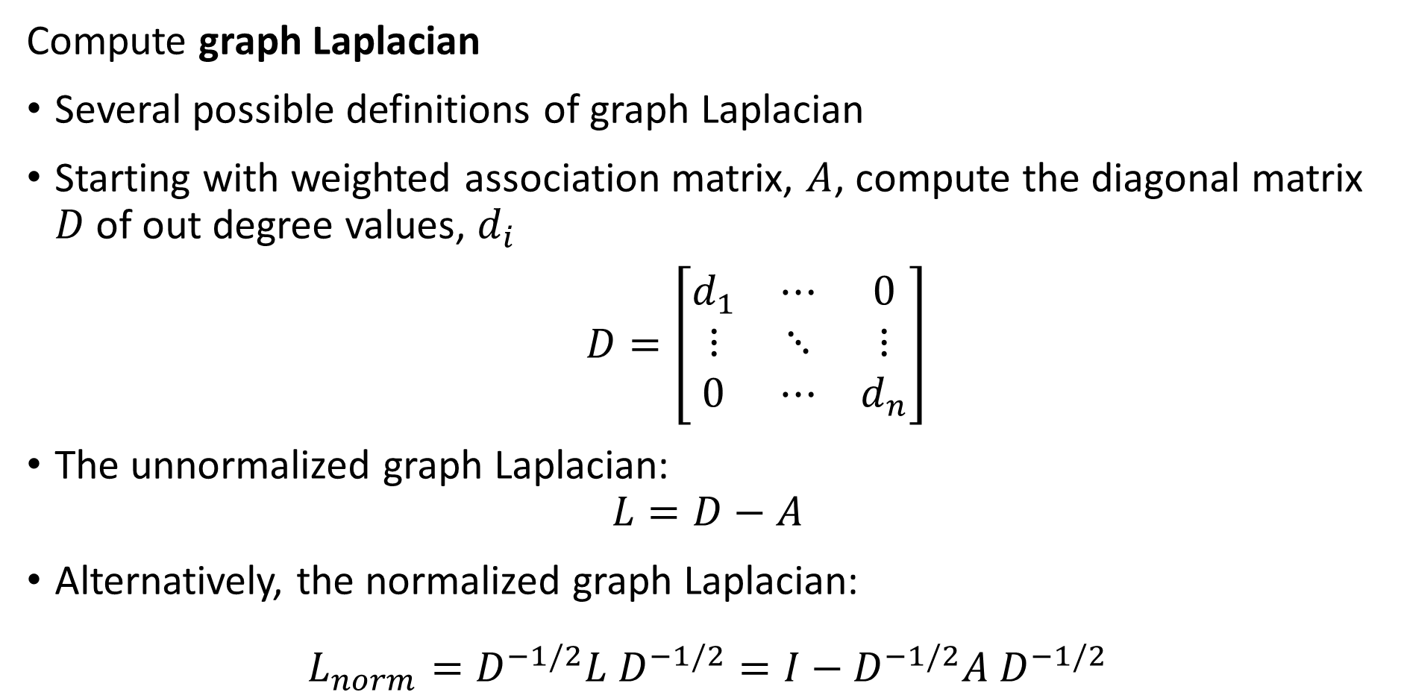
Spectral Clustering
Compute graph Laplacian
Several possible definitions of graph Laplacian
Starting with weighted association matrix, $A$, compute the diagonal matrix $D$ of out degree values, $d_{i}$
$D=\left[\begin{matrix}d_{1} & ⋯ & 0 \\ ⋮ & ⋱ & ⋮ \\ 0 & ⋯ & d_{n}\end{matrix}\right]$
The unnormalized graph Laplacian:
$$L=D−A$$
Alternatively, the normalized graph Laplacian:
$$L_{norm}=D^{−1/2}{L D}^{−1/2}=I−D^{−1/2}{A D}^{−1/2}$$

Slide 39
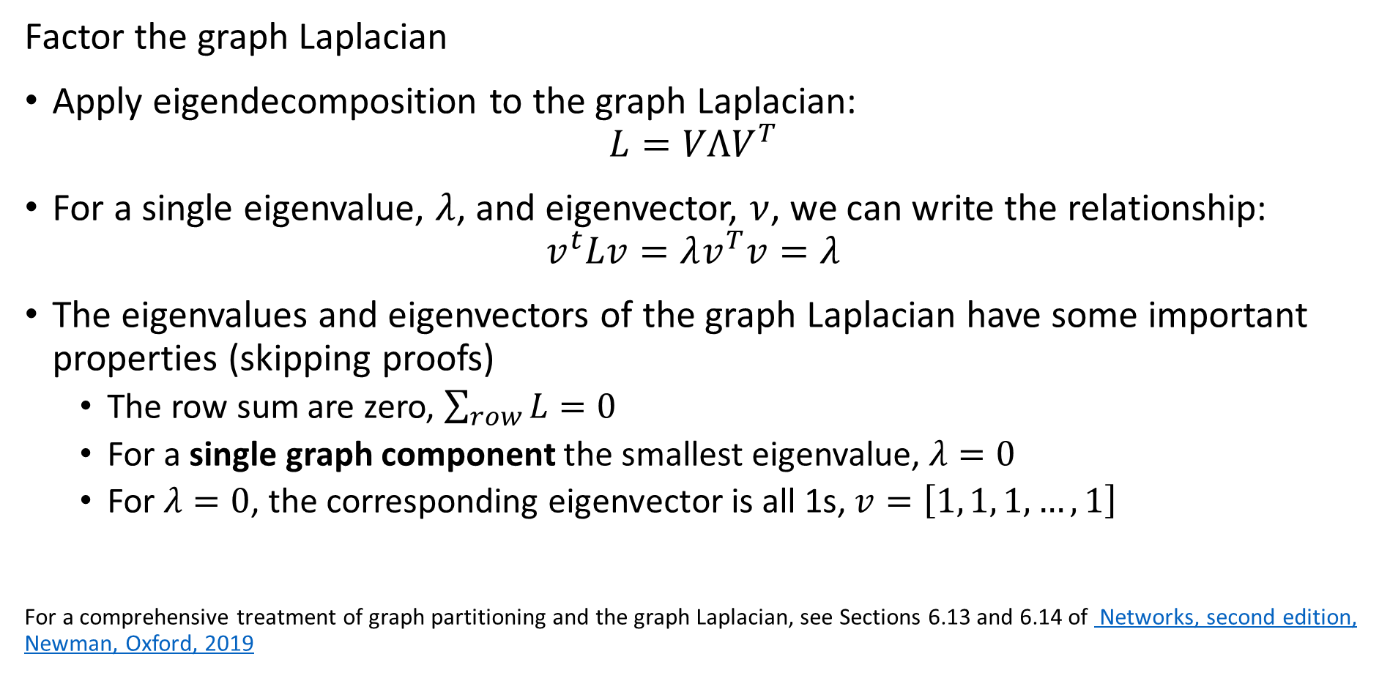
Spectral Clustering
Factor the graph Laplacian
Apply eigendecomposition to the graph Laplacian:
$$L=VΛV^{T}$$
For a single eigenvalue, $λ$, and eigenvector, $ν$, we can write the relationship:
$$v^{t}Lv=λv^{T}v=λ$$
The eigenvalues and eigenvectors of the graph Laplacian have some important properties (skipping proofs)
The row sum are zero, $\sum_{row}{L}=0$
For a single graph component the smallest eigenvalue, $λ=0$
For $λ=0$, the corresponding eigenvector is all 1s, $v=\left[1, 1, 1, …, 1\right]$
For a comprehensive treatment of graph partitioning and the graph Laplacian, see Sections 6.13 and 6.14 of Networks, second edition, Newman, Oxford, 2019

Slide 40
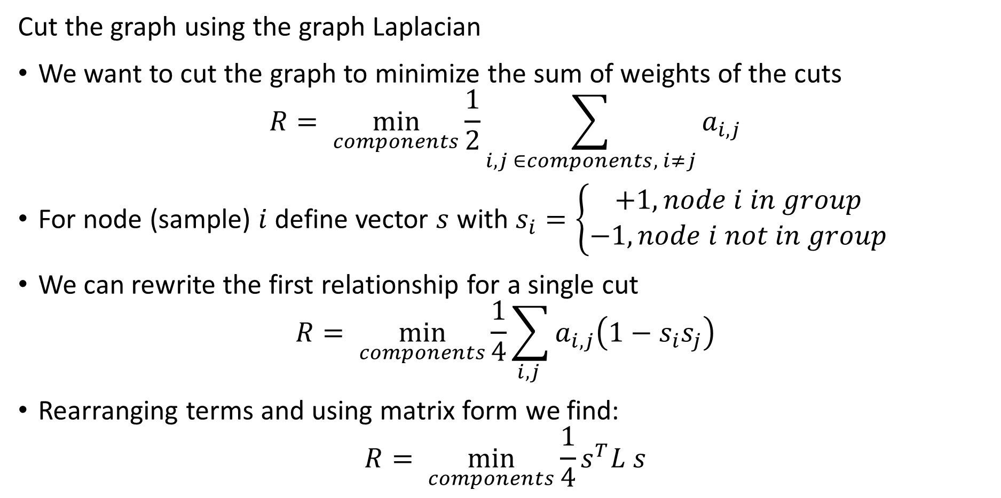
Spectral Clustering
Cut the graph using the graph Laplacian
We want to cut the graph to minimize the sum of weights of the cuts
$$R= \min_{components}{\frac{1}{2}\sum_{i,j ∈components, i≠j}{a_{i,j}}}$$
For node (sample) $i$ define vector $s$ with $s_{i}=\left\{\begin{aligned}+1, node i in group \\ −1, node i not in group\end{aligned}\right.$
We can rewrite the first relationship for a single cut
$$R= \min_{components}{\frac{1}{4}\sum_{i,j }{a_{i,j}\left(1−s_{i}s_{j}\right)}}$$
Rearranging terms and using matrix form we find:
$$R= \min_{components}{\frac{1}{4}s^{T}L s}$$

Slide 41
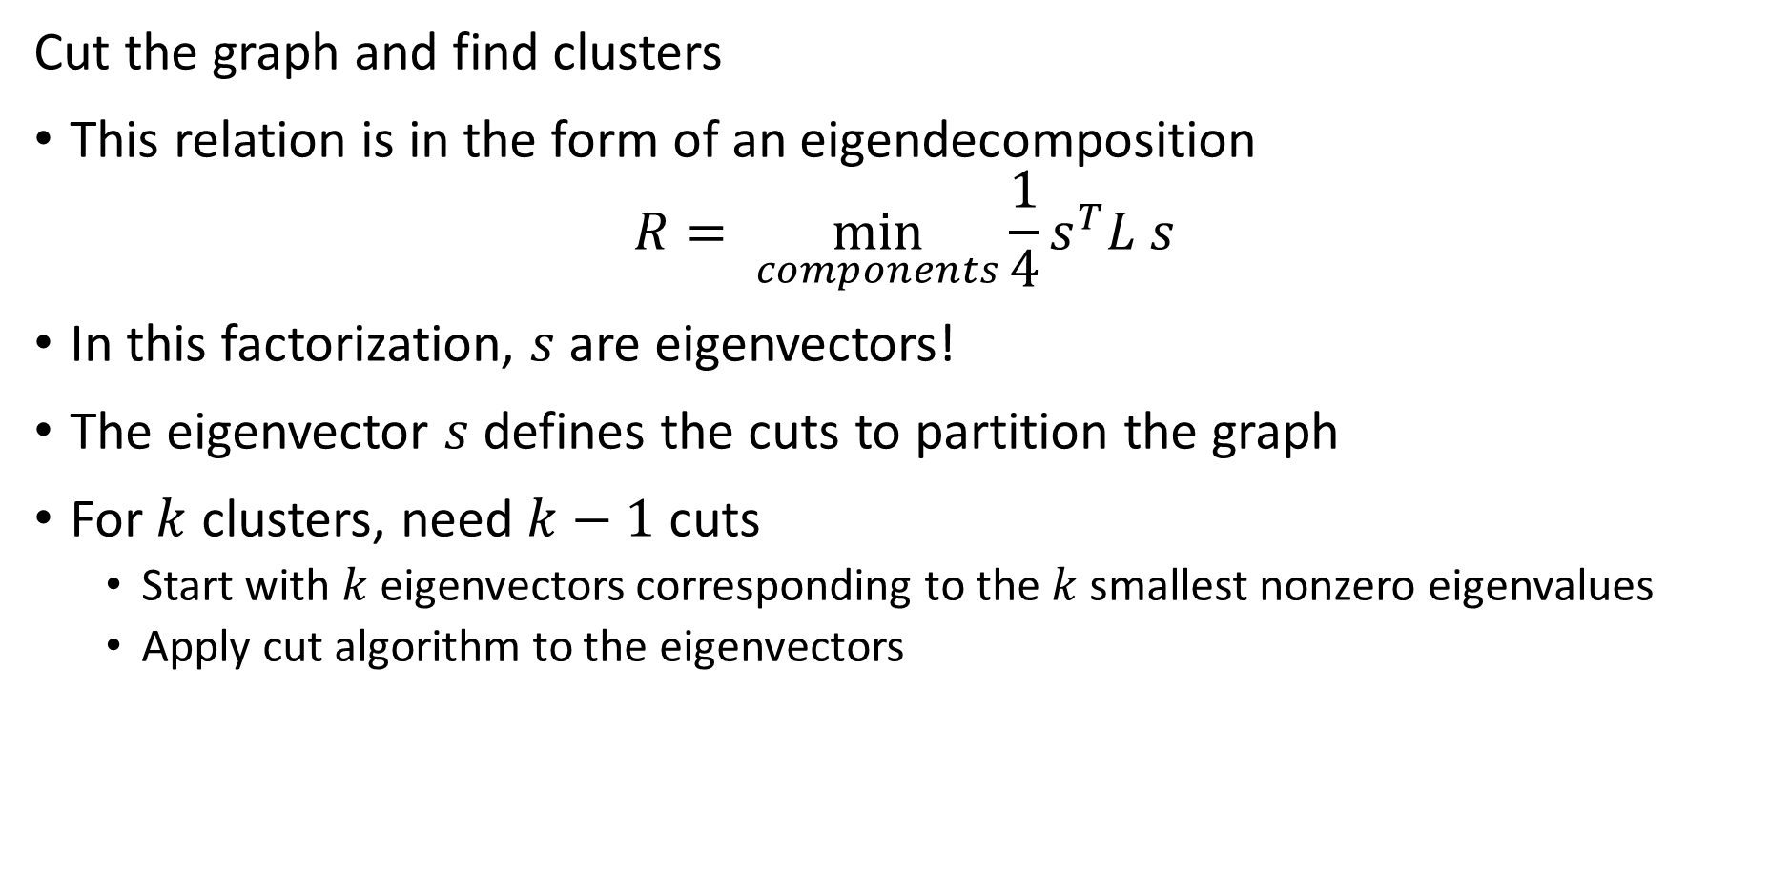
Spectral Clustering
Cut the graph and find clusters
This relation is in the form of an eigendecomposition
$$R= \min_{components}{\frac{1}{4}s^{T}L s}$$
In this factorization, $s$ are eigenvectors!
The eigenvector $s$ defines the cuts to partition the graph
For $k$ clusters, need $k−1$ cuts
Start with $k$ eigenvectors corresponding to the $k$ smallest nonzero eigenvalues
Apply cut algorithm to the eigenvectors

Slide 42
Spectral Clustering
Spectral clustering is a graph-based state of the art clustering method
Spectral clustering follows these steps:
Construct the association matrix
Compute the graph Laplacian from the association matrix
Factor the graph Laplacian
Partition the graph by k-1 eigenvectors
In summary, spectral clustering constructs clusters on the orthogonal projections of the Laplacian matrix
For a rigorous introduction to spectral clustering see this tutorial article by von Luxburg

Slide 43
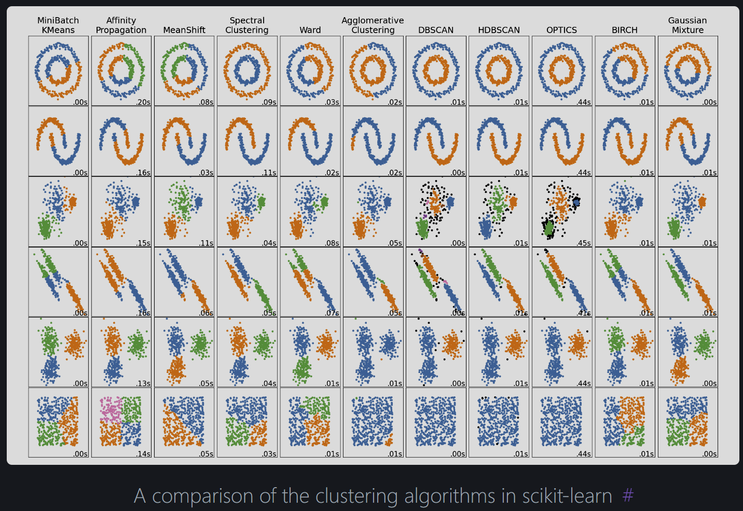
Summary
From Scikit-Learn Clustering User Guide

Slide 44
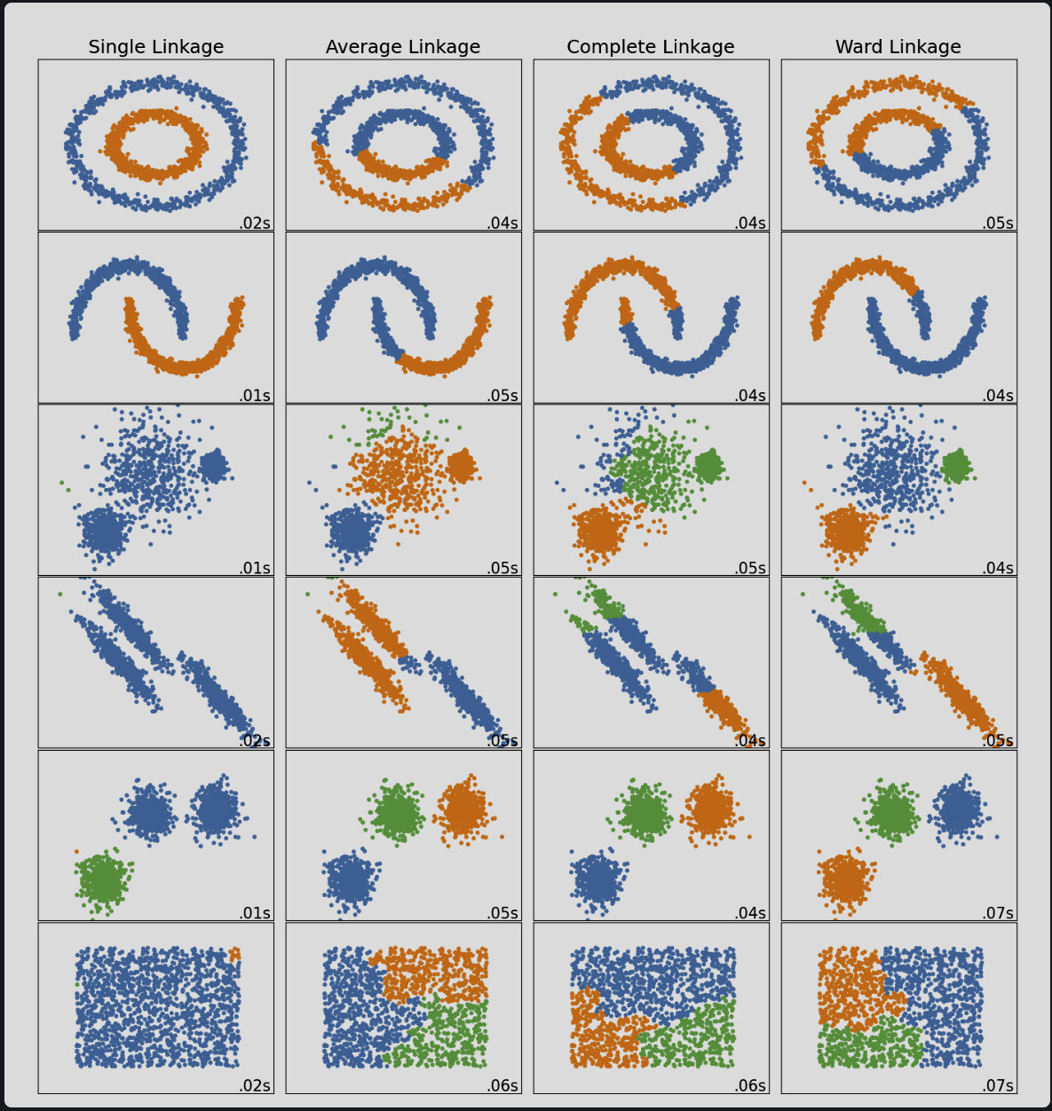
Summary
From Scikit-Learn Clustering User Guide

Slide 45
Summary
Unsupervised learning methods learn structure of data
Structure is learned by determining association between cases
Association based on measures of proximity, distance or dissimilarity
Clustering algorithms are data mining methods
Data mining seeks to find interesting relationships in data
We have already encountered feature importance as a data mining method

Slide 46
Summary
Algorithms can use different distance or dissimilarity metrics
Structure based on distance metrics
Different algorithms use different metrics
What are the ideal properties of clusters?
Good clusters have two properties
Compactness: We what the clusters to be small with members close to each other
Separation: We want the clusters are well separated, a closeness property

Slide 47
Summary
Different models and dissimilarity metrics will give different results
Dissimilarity metrics usually matter more than model choice
But which one should we use?
Evaluation is a significant problem with for unsupervised learning
There are no labels for objective evaluation
Evaluation is often subjective
But, do we have to pick one best model?
No
Different models can show different useful relationships

Slide 48
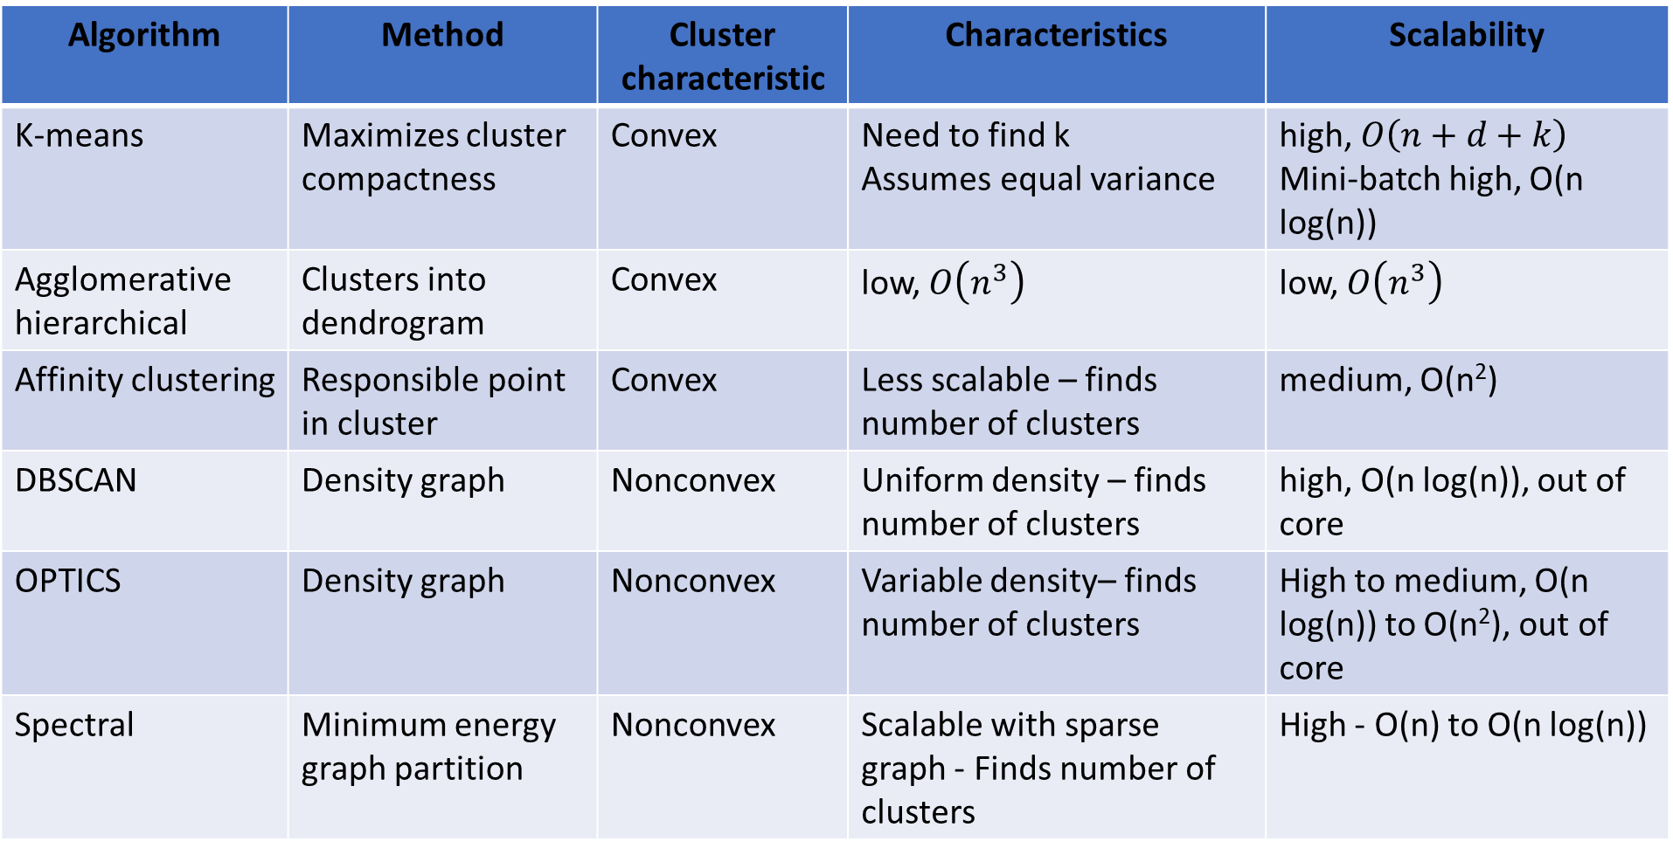
Summary
Algorithm | Method | Cluster characteristic | Characteristics | Scalability
K-means | Maximizes cluster compactness | Convex | Need to find k Assumes equal variance | high, $O\left(n+d+k\right)$ Mini-batch high, O(n log(n))
Agglomerative hierarchical | Clusters into dendrogram | Convex | low, $O\left(n^{3}\right)$ | low, $O\left(n^{3}\right)$
Affinity clustering | Responsible point in cluster | Convex | Less scalable – finds number of clusters | medium, O(n²)
DBSCAN | Density graph | Nonconvex | Uniform density – finds number of clusters | high, O(n log(n)), out of core
OPTICS | Density graph | Nonconvex | Variable density– finds number of clusters | High to medium, O(n log(n)) to O(n²), out of core
Spectral | Minimum energy graph partition | Nonconvex | Scalable with sparse graph - Finds number of clusters | High - O(n) to O(n log(n))

